Slide 1

Machine Learning
And Regression

Slide 2
Contents
What is Machine learning?
Regression - Intuition
Multiple Regression
Regression Assumptions

Slide 3
Machine Learning - Definition
A computer program is said to learn from Experience (E), with respect to some class of tasks (T) and performance measure (P), if it’s performance P at tasks T, improves with Experience E
(Tom M Mitchell)

Slide 4
Machine Learning(Supervised) - Schema
Task
Features
Output
Data
Model
Performance =
How well is the task is done
Match | Toss Winning | Batting First | Result
1 | Y | Y | W
2 | N | Y | L
3 | Y | N | W
4 | Y | N | L
5 | N | Y | W
6 | Y | N | W
7 | Y | N | W
8 | Y | N | L
9 | N | Y | L
10 | Y | N | W
Training Data
Learning
Experience

Slide 5
Machine Learning(Supervised) - Schema
The learning achieved here is with the help of available labelled target variables (at least for a reasonable number of cases). Such learning is termed “Supervised” learning

Slide 6
Machine Learning(UnSupervised) - Schema
Task
Features
Output
Performance
=
How well is the task is done
Domain Objects
Data
Model
Match | Toss Winning | Batting First
1 | Y | Y
2 | N | Y
3 | Y | N
4 | Y | N
5 | N | Y
6 | Y | N
7 | Y | N
8 | Y | N
9 | N | Y
10 | Y | N
Experience
In cases where, there is no labelled target variables are available the learning is termed “Unsupervised” learning.

Slide 7
Machine Learning - Tasks
Machine Learning
What is Learnt
(Task)
How is it Learnt?
(Experience)
How well is it learnt?
(Performance)

Slide 8
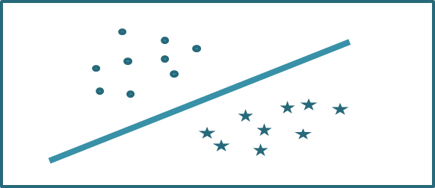
Tasks - Classification - Binary
Match | Toss Winning | Batting First | Result
1 | Y | Y | W
2 | N | Y | L
3 | Y | N | W
4 | Y | N | L
5 | N | Y | W
6 | Y | N | W
7 | Y | N | W
8 | Y | N | L
9 | N | Y | L
10 | Y | N | W
Output Variable – Categorical, Can take only two values
Input Variables – Can be any in number, Can be continuous or categorical

Slide 9
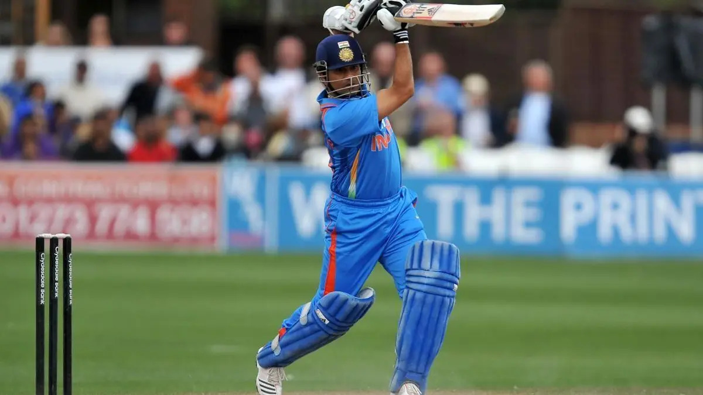

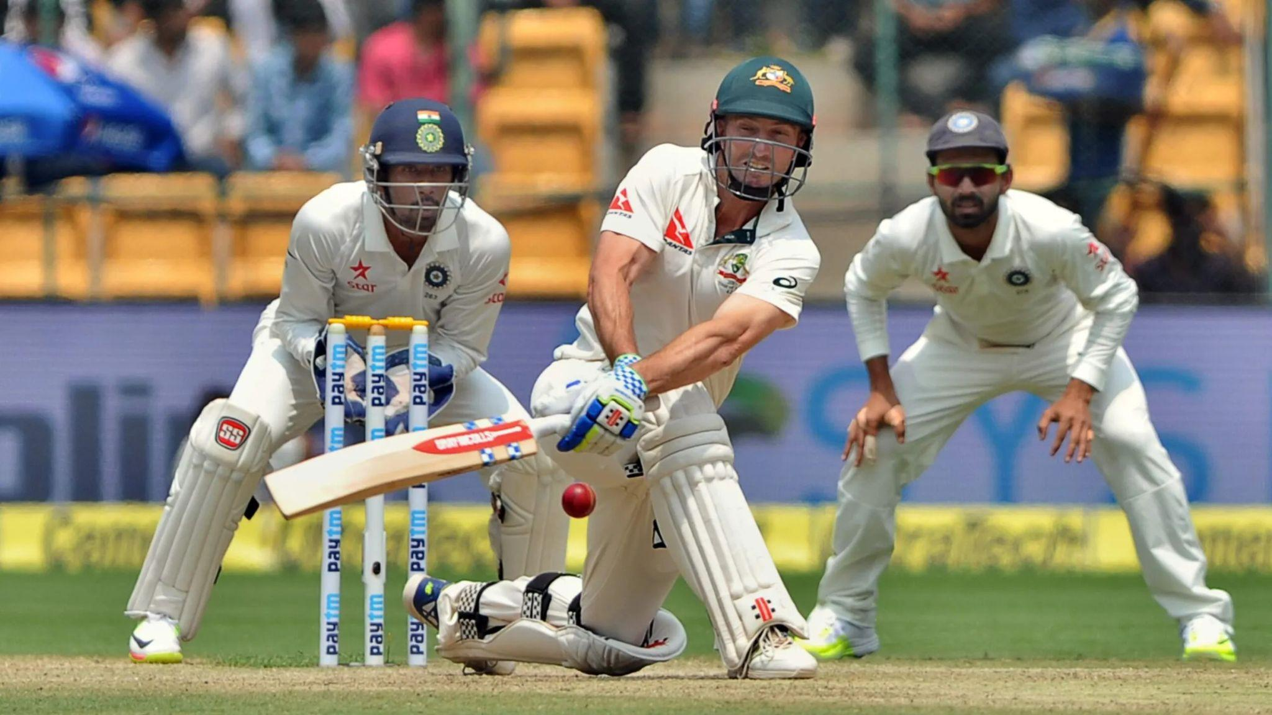
Tasks - Classification - MultiClass
Different Types of Shots:
Drive
Pull
Sweep
Output Variable – Categorical, Can take any number of values
Input Variables – Can be any in number, Can be continuous or categorical

Slide 10
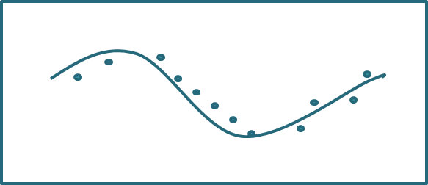
Task - Function Approximation
Average | Training Intensity
57 | 93
58 | 110
59 | 111
60 | 99
60 | 122
61 | 115
61 | 116
62 | 110
62 | 122
62 | 134
63 | 128
63 | 123
64 | 117
64 | 135
65 | 129
66 | 128
66 | 148
67 | 135
68 | 142
69 | 155
Batting Average (y) = 40.16+ 0.18 * Training Intensity(x)
Output Variable – Continuous
Input Variables – Can be any in number, Continuous
(Categorical Input variables can be handled through special methods)

Slide 11
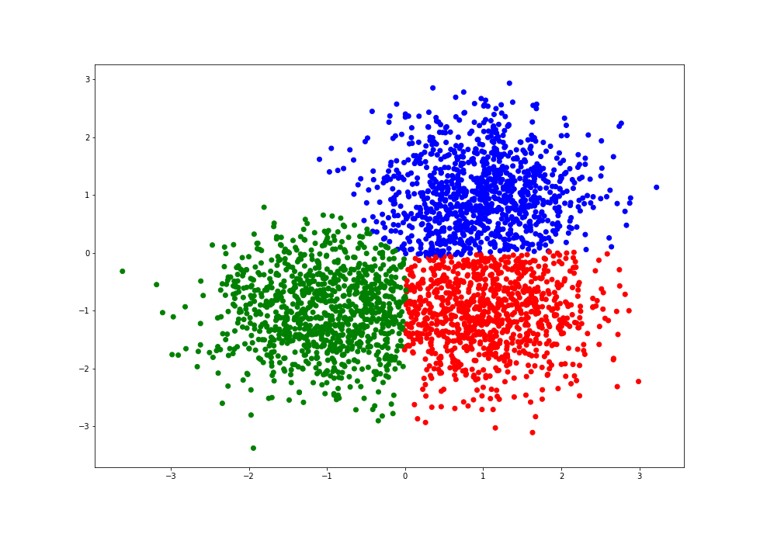
Task - Identifying Patterns - Grouping
Input Variables – Can be any in number, Continuous
(Categorical Input variables can be handled through special methods)
Output – Group membership for each Instance, Group Centroids

Slide 12
Task - Identifying Patterns - Grouping
Instances | V₁ | V₂ | V₃ | V₄ | V_{n-1} | V_{n}
1
2
3
---
998
999
1000
Instances | V₁ | V₂ | V₃ | V₄ | V_{n-1} | V_{n}
Group 1
Group 2
Group m

Slide 13
Task - Identifying Patterns - Dimensionality
Reduction
Input Variables – Can be any in number, Continuous
Instances | F₁ | F₂ | F_{m-1} | F_{m}
1
2
3
4
---
---
---
998
999
1000
Instances | V₁ | V₂ | V₃ | V₄ | V_{n-1} | V_{n}
1
2
3
---
998
999
1000

Slide 14
Regression Analysis

Slide 15
Regression Analysis - What is it?
Imaginary Conversation:
Captain: Our team's run rate has been inconsistent this season. We need to improve our average run rate by r % in the upcoming matches to reach our target.
Coach: But achieving that will likely require some adjustments in our strategies and training routines.

Slide 16
Regression Analysis - What is it?
Captain: How can you be certain that changing our strategies will actually lead to a higher run rate?
Coach: I've been analyzing the match statistics over the past few seasons and gathered data on various factors that could influence our run rate.

Slide 17
Regression Analysis - What is it?
Captain: Can you estimate how much we'll need to modify our approach to reach the desired run rate?
Coach: Of course, our analysts have developed a regression equation based on historical data.
RunRate(y) = 4.5 + 0.8 Training Intensity(x)

Slide 18
Regression Analysis - What is it?
Captain: Are you saying that this equation can accurately predict our run rate?
Statistician: The equation is actually formulated as:
RunRate(y) = 4.5 + 0.8 Training Intensity(x) + e
Captain: How Large is the Error?
What we have just heard is the development of a regression analysis. What is known as a Simple Linear Regression

Slide 19
Regression Analysis - What is it?
A regression analysis establishes a functional relation between a output variable (referred to as the Dependent Variable – Run Rate in our example)
and one or more input variables (referred to as independent variable/s – Training Intensity in our example).
Such a relationship is used to:
Predict a value of an output variable, given a value for an input variable
To understand the “effect” that independent variable/s have on the output variable

Slide 20
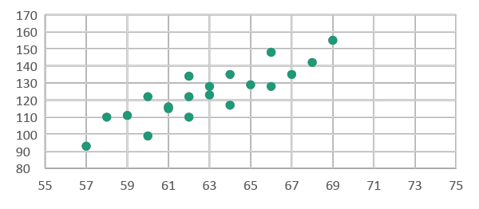
Regression Analysis - What is it?
Simple Linear Regression:
If the relationship between the variables is assumed to be straight line form, such as
If it involves only ONE input variable & ONE output variable
If the relationship is not linear such as,
Simple Non-Linear Regression:

Slide 21
Regression Analysis - What is it?
In walks the team's analyst into the conversation:
Cricket Analyst: I believe the number of matches played per player also has an influence on the team's runrate.
Captain: So, you're suggesting that the equation for predicting our runrate should consider not only training intensity but also the number of matches played per player?

Slide 22
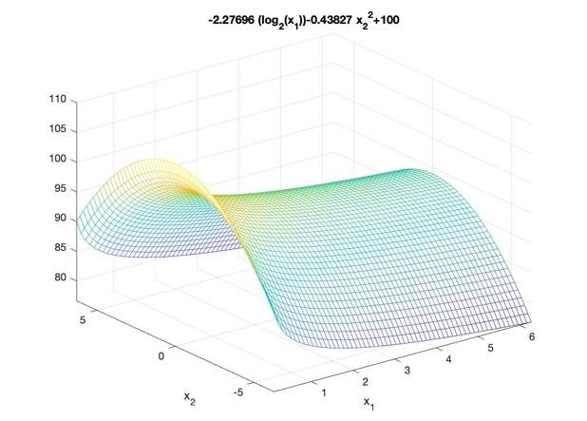
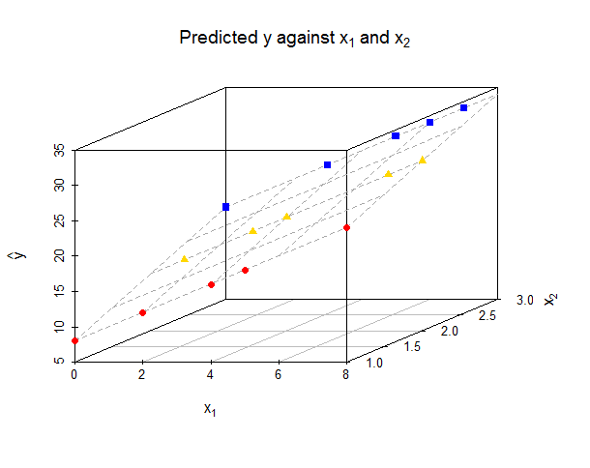
Regression Analysis - What is it?
Performance Analyst: Exactly. Based on the historical data we've gathered, the regression equation could be something like this:
RunRate(y) = 30 + 0.6 Training Intensity(x1) + 0.2 Matches Played Per Player(x2)
Multiple Linear Regression:
Multiple Non - Linear Regression:
If it involves Multiple input variables & One output variable

Slide 23
Regression Analysis - What is it?
Data Conditions for Regression:
Dependent (Output) Variable: Metric data
Independent (Input) Variable/s: Metric data
When some of the ,Independent Variables are non-metric, an analysis called Dummy Variable regression can be used

Slide 24
Regression Intuition

Slide 25
Regression Intuition
Suppose we had Batting Averages of 20 players
Batting Average of Player
57
58
59
60
60
61
61
62
62
62
63
63
64
64
65
66
66
67
68
69
Best Guess
62.85
62.85
62.85
62.85
62.85
62.85
62.85
62.85
62.85
62.85
62.85
62.85
62.85
62.85
62.85
62.85
62.85
62.85
62.85
62.85
Error
-5.85
-4.85
-3.85
-2.85
-2.85
-1.85
-1.85
-0.85
-0.85
-0.85
0.15
0.15
1.15
1.15
2.15
3.15
3.15
4.15
5.15
6.15
Squared Error
34.22
23.52
14.82
8.12
8.12
3.42
3.42
0.72
0.72
0.72
0.02
0.02
1.32
1.32
4.62
9.92
9.92
17.22
26.52
37.82
What would be the best guess you can offer on any individual player’s Batting Average?
It would be the average of batting averages of the 20 players = 62.85
Supposing we use the average of all batsmen as the best guess to predict the batting average of each of the 20 players – what would be the error of our estimations?
Error = (Observed – Predicted) Also Called Residual
A better estimate of error in estimation would be the sum of squared errors
Sum of Squared Errors = 206.55

Slide 26
Regression Intuition
Supposing we had the Training Intensity the of 20 players in addition had their Batting Average as well
Batting Average of Player
57
58
59
60
60
61
61
62
62
62
63
63
64
64
65
66
66
67
68
69
Training Intensity of the Player
93
110
111
99
122
115
116
110
122
134
128
123
117
135
129
128
148
135
142
155
Batting Average of Player | Training Intensity of the Player
57 | 93
60 | 99
58 | 110
62 | 110
59 | 111
61 | 115
61 | 116
64 | 117
60 | 122
62 | 122
63 | 123
63 | 128
66 | 128
65 | 129
62 | 134
64 | 135
67 | 135
68 | 142
66 | 148
69 | 155
What would be the best guess you can offer on any player’s Batting Average?
One method could be to break group up into two sub-groups, on the basis of Training Intensity
Batting Average (when Training Intensity < = 123) = 60.63
Batting Average (when Training Intensity >123) = 65.56

Slide 27
Regression Intuition
Supposing we had the Training Intensity of the players in addition to their batting averages as well
Training Intensity of the Player
93
99
110
110
111
115
116
117
122
122
123
128
128
129
134
135
135
142
148
155
Batting Average of Player
57
60
58
62
59
61
61
64
60
62
63
63
66
65
62
64
67
68
66
69
Batting Average (when Training Intensity < = 123) = 60.63
Batting Average (when Training Intensity >123)
= 65.56
Best Guess | Error | Squared Error
60.63 | -3.63 | 13.18
60.63 | -0.63 | 0.40
60.63 | -2.63 | 6.92
60.63 | 1.37 | 1.88
60.63 | -1.63 | 2.66
60.63 | 0.37 | 0.14
60.63 | 0.37 | 0.14
60.63 | 3.37 | 11.36
60.63 | -0.63 | 0.40
60.63 | 1.37 | 1.88
60.63 | 2.37 | 5.62
65.56 | -2.56 | 6.55
65.56 | 0.44 | 0.19
65.56 | -0.56 | 0.31
65.56 | -3.56 | 12.67
65.56 | -1.56 | 2.43
65.56 | 1.44 | 2.07
65.56 | 2.44 | 5.95
65.56 | 0.44 | 0.19
65.56 | 3.44 | 11.83
The total error in prediction (Computed as Sum of Squared Errors) has reduced from 206.55 to 86.77
Problems of splitting data:
Problem 1: You are using lesser data for each group
Problem 2: You are Over-fitting, by a very complex model
Sum of Squared Errors = 86.77

Slide 28
Regression Intuition
Regression provides a linear equation such as
Batting Average (y) = b₀ (Constant) + b₁ * Training Intensity(x)
To estimate the value of strike rate for each observation
Regression is a parsimonious approach – One that uses data efficiently in summarizing our expectations about the dependent variable (Batting Average in this case)

Slide 29
Regression Intuition
Supposing we had the training intensity of the players in addition to their batting averages as well
Training Intensity of the Player | Batting Average of Player | Regression Estimate | Error | Squared Error
93 | 57 | 57.2 | -0.2 | 0.05
99 | 60 | 58.3 | 1.7 | 2.78
110 | 58 | 60.4 | -2.4 | 5.53
110 | 62 | 60.4 | 1.6 | 2.72
111 | 59 | 60.5 | -1.5 | 2.36
115 | 61 | 61.3 | -0.3 | 0.07
116 | 61 | 61.5 | -0.5 | 0.20
117 | 64 | 61.6 | 2.4 | 5.59
122 | 60 | 62.6 | -2.6 | 6.52
122 | 62 | 62.6 | -0.6 | 0.31
123 | 63 | 62.7 | 0.3 | 0.07
128 | 63 | 63.7 | -0.7 | 0.43
128 | 66 | 63.7 | 2.3 | 5.50
129 | 65 | 63.8 | 1.2 | 1.35
134 | 62 | 64.8 | -2.8 | 7.60
135 | 64 | 64.9 | -0.9 | 0.88
135 | 67 | 64.9 | 2.1 | 4.24
142 | 68 | 66.2 | 1.8 | 3.15
148 | 66 | 67.3 | -1.3 | 1.76
155 | 69 | 68.6 | 0.4 | 0.15
If we use an equation such as
Batting Average (y) = 40.16+ 0.1835 * Training Intensity(x)
If training intensity for a batsman is 115, then his regression predicted Batting Average = 40.16+ 0.1835 * 115 = 61.3
From the original total error of 206.55, we have now reduced the error to 51.26 using a regression equation for prediction
Sum of Squared Errors = 51.26

Slide 30
Regression Intuition
Batting Average (y) as a function of Training Intensity (x)
Measure of uncertainty
= 206.55
Measure of uncertainty
= 86.77
Batting Average (y) as a function of Training Intensity (x)
Now, How did we get an equation like:
Batting Average (y) = 40.16+ 0.18 * Training Intensity(x)
Batting Average (y) = b₀ (Constant) + b₁ * Training Intensity(x)
Measure of uncertainty
= 51.26
The objective of the regression algorithm is to choose the values of b₀ and b₁ in such a way so that the Sum of Squared Errors are minimized

Slide 31
Regression Intuition
Batting Average (y) = b₀ (Constant) + b₁ * Training Intensity(x)
The objective of the regression algorithm is to choose the values of b₀ and b₁ in such a manner, so as to reduce the uncertainty (measured by the sum of squared errors of the regression estimates) to the lowest possible value
Least Squares Estimators (OLS) is one method to arrive at the optimum values for model parameters (b₀ and b₁)
Making certain assumptions about the data, and variables
Batting Average(y) as a function of Training Intensity(x)

Slide 32

Regression Intuition - How good is our Model?
Batting Average (y) = 40.16+ 0.18 * Training Intensity(x)
Regression of Batting Average
Sum of Squares
= 206.55
Sum of Squares
= 51.26
Regression Statistics
Multiple R | 0.867072
R Square | 0.751815
Adjusted R Square | 0.738027
Standard Error | 1.68758
Observations | 20
R² = $\frac{206.55 −51.26}{206.55}$ = 0.752
R² is a measure of Goodness of fit of the model
R² measures the amount of variance in an output variable explained by using an variable and regression.
The higher the R², the greater the explanatory power of the model.

Slide 33
Regression Intuition - How good is our Model?
The Problem with R² :
R² will increase, whenever you add another independent variable, however meaningless it could be
For Example: Batting Average (y) = b₀ (Constant) + b₁ * Training Intensity(x₁) + b₂ * Number Cousins (x₂)
Batting Average (y) = 37.67 + 0.185 * Training Intensity(x₁) + 0.281 * Number of Cousins (x₂)
R² =0.757 as compared to a R² of 0.752 in the first model
Training Intensity | Batting average | # of Cousins
93 | 57 | 9
110 | 58 | 8
99 | 60 | 7
111 | 59 | 9
115 | 61 | 8
122 | 60 | 7
110 | 62 | 9
116 | 61 | 8
122 | 62 | 7
128 | 63 | 9
134 | 62 | 8
117 | 64 | 7
123 | 63 | 9
129 | 65 | 8
135 | 64 | 7
128 | 66 | 9
135 | 67 | 8
148 | 66 | 7
142 | 68 | 9
155 | 69 | 8

Slide 34
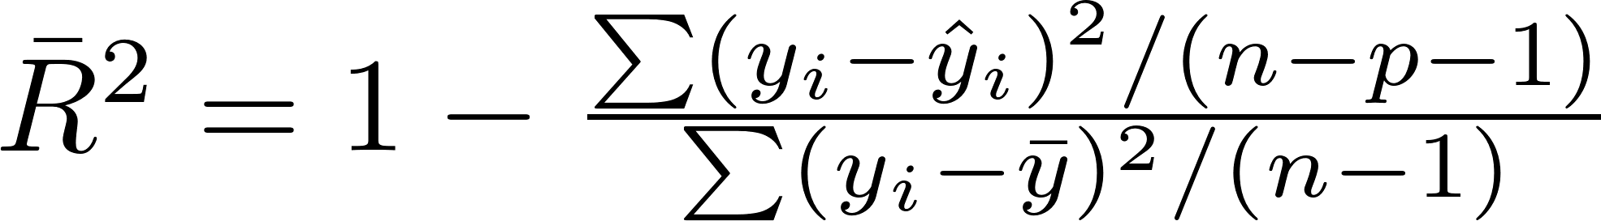
Regression Intuition - How good is our Model?
Concept of Adjusted R²:
Is a way to penalize additions of variables
Adjusted R² =0.737 as compared to
Adjusted R² of 0.738 in the first model
Regression Statistics (Without Cousins)
Multiple R | 0.867072
R Square | 0.751815
Adjusted R Square | 0.738027
Standard Error | 1.68758
Observations | 20
Regression Statistics (With Cousins)
Multiple R | 0.869879
R Square | 0.75669
Adjusted R Square | 0.728065
Standard Error | 1.719366
Observations | 20
You choose between two alternate models on the basis of Adjusted R², whichever has the higher adjusted R²

Slide 35
Statistical Tests on the model?
Is our model significant? Will regression model work for the population?
If this value is smaller than 0.05, then our Model is significant at 95% confidence level
ANOVA
 | df | SS | MS | F | Significance F
Regression | 1 | 155.2873 | 155.2873 | 54.52645 | 7.52114E-07
Residual | 18 | 51.26268 | 2.847926
Total | 19 | 206.55
Our Model is Significant
Are the coefficients of regression significant? Can I use the same equation for the population?
If these values are smaller than 0.05, then the regression coefficients are significant at 95% confidence level
 | Coefficients | Standard Error | t Stat | P-value
Intercept | 40.15727 | 3.096227 | 12.96974 | 1.43E-10
Training Intensity | 0.183598 | 0.024864 | 7.384203 | 7.52E-07
The regression coefficients are Significant

Slide 36
Regression - Interpretation of Coefficients
Batting Average (y) = 40.16+ 0.18 * Training Intensity(x)
The constant in the equation is arrived through an equation which ensures that the line passes through the mean values of X and Y
Even if not statistically significant the constant in the equation is normally retained, and never discarded
The coefficient of training intensity is 0.18, and the interpretation is that when the training intensity changes by 1 , the batting average will change by 0.18

Slide 37
Multiple Regression

Slide 38
Multiple Linear Regression - Example
y (Total Runs) | x1 (Dot Balls) | x2 (Boundaries) | x3 (Main Bowlers' strike rate) | x4 (Main Batsmen strike rate)
250 | 90 | 30 | 28 | 90
280 | 70 | 25 | 30 | 85
220 | 100 | 20 | 35 | 95
300 | 60 | 35 | 25 | 80
260 | 90 | 28 | 27 | 88
210 | 110 | 15 | 38 | 75
320 | 60 | 40 | 23 | 110
240 | 95 | 22 | 32 | 82
290 | 75 | 30 | 29 | 87
Cricket Data
y (Total Runs)
X₁ (Dot Balls)
X₂ (Boundaries {4’s and 6’s})
X₃ (Main Bowlers’ Strike Rate)
X₄ (Main Batsmens’ Strike Rate)

Slide 39
Multiple Linear Regression - Model
Cricket Data
Y (Total Runs)
X₁ (Dot Balls)
X₂(Boundaries {4’s and 6’s})
X₃ (Main Bowlers’ Strike Rate)
X₄ (Main Batsmens’ Strike Rate)
Regression Statistics
Multiple R | 0.983069
R Square | 0.966425
Adjusted R Square | 0.93285
Standard Error | 9.608885
Observations | 9
How Good is our model?
Is our model significant?
ANOVA
 | df | SS | MS | F | Significance F
Regression | 4 | 10630.68 | 2657.669 | 28.78425 | 0.003306
Residual | 4 | 369.3227 | 92.33067
Total | 8 | 11000
Y = 369.21-1.51X₁ + 1.04 X₂ - 0.47X₃ + 0.06X₄
p – values of X₂, X₃, X₄ are much higher than 0.05. We cannot use this equation as it is..
Are the regression coefficients significant?
 | Coefficients | Standard Error | t Stat | P-value
Intercept | 369.21 | 148.65 | 2.48 | 0.07
X1 Dot Balls | -1.51 | 0.41 | -3.70 | 0.02
x2 (Boundaries) | 1.04 | 2.30 | 0.45 | 0.67
x3 (Main Bowlers' strike rate) | -0.47 | 3.12 | -0.15 | 0.89
x4 (Main Batsmens' strike rate) | 0.06 | 0.46 | 0.13 | 0.90

Slide 40
Multiple Linear Regression - Model
Cricket Data
Y (Total Runs)
X₁ (Dot Balls)
X₂(Boundaries {4’s and 6’s})
X₃ (Main Bowlers’ Strike Rate)
Regression Statistics
Multiple R | 0.982992
R Square | 0.966274
Adjusted R Square | 0.946038
Standard Error | 8.613818
Observations | 9
How Good is our model?
Is our model significant?
ANOVA
 | df | SS | MS | F | Significance F
Regression | 3 | 10629.01 | 3543.004 | 47.75075 | 0.00042
Residual | 5 | 370.9893 | 74.19786
Total | 8 | 11000
Y = 365.13-1.49 X₁ + 1.20 X₂ - 0.35X₃
p – values of X₃, X₄ are much higher than 0.05. We cannot use this equation as it is..
Are the regression coefficients significant?
 | Coefficients | Standard Error | t Stat | P-value
Intercept | 365.13 | 130.44 | 2.80 | 0.04
x1 (Dot Balls) | -1.49 | 0.35 | -4.30 | 0.01
x2 (Boundaries) | 1.20 | 1.76 | 0.68 | 0.53
x3 (Main Bowlers' strike rate) | -0.35 | 2.66 | -0.13 | 0.90

Slide 41
Multiple Linear Regression - Model
Regression Statistics
Multiple R | 0.982934
R Square | 0.966159
Adjusted R Square | 0.954879
Standard Error | 7.876656
Observations | 9
Cricket Data
Y (Total Runs)
X₁ (Dot Balls)
X₂(Boundaries {4’s and 6’s})
How Good is our model?
Is our model significant?
ANOVA
 | df | SS | MS | F | Significance F
Regression | 2 | 10627.75 | 5313.875 | 85.65003 | 3.88E-05
Residual | 6 | 372.2503 | 62.04172
Total | 8 | 11000
p – values of X₂, is higher than 0.05.
At 90% confidence levels these coefficients are OK, but not at 95% levels.
Y = 349.38-1.49X₁ + 1.41 X₂
Are the regression coefficients significant?
 | Coefficients | Standard Error | t Stat | P-value
Intercept | 349.38 | 45.02 | 7.76 | 0.00
x1 (Dot Balls) | -1.49 | 0.32 | -4.71 | 0.00
x2 (Boundaries) | 1.41 | 0.74 | 1.91 | 0.10

Slide 42
Regression Assumptions

Slide 43
Regression Assumptions - Model - Linearity
Assumptions about the form of the model:
The relationship between the response variable (Y), and the predictor variables (X₁ , X₂ , X₃ , X₄ ,…., X_{p} ) is assumed to be linear in the parameters (β₀, β₁, β₂, β₃,….., β_{p}), such as:
Y = β₀ + β₁ X₁ + β₂ X₂ + β₃ X₃ +…….+ β_{p} X_{p} +ε
Consequences of violation of this assumption:
Poor fit of the model, Inaccurate predictions

Slide 44
Regression Assumptions - Errors
Assumptions about the errors:
There are three assumptions in the above expression:
The error terms at each X value follows a Normal Distribution
The mean value of errors at each X value is Zero
The error distribution at each X value has the same (but unknown) variance of σ²

Slide 45
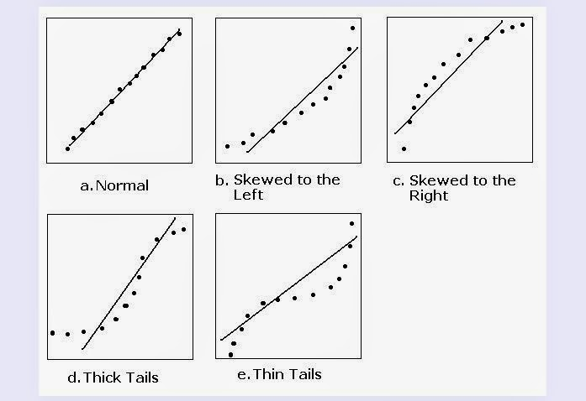
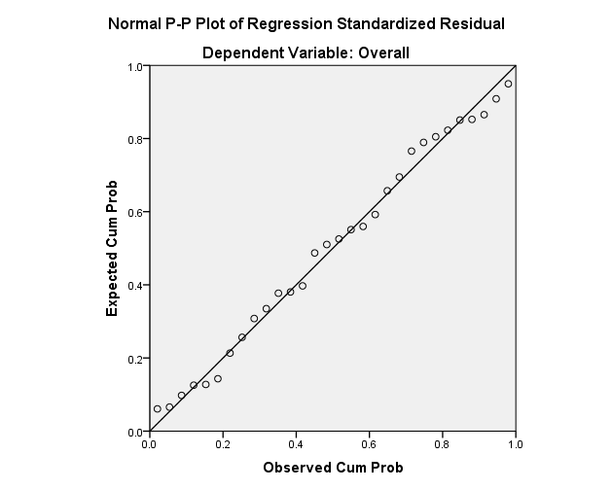
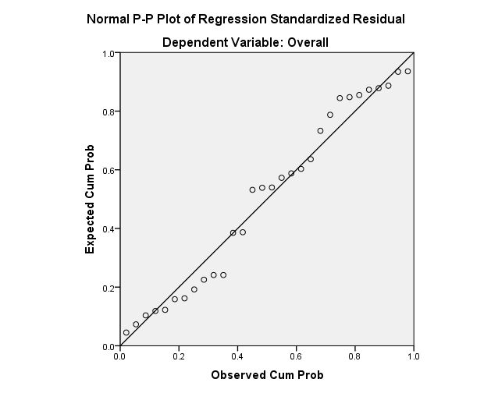


Regression Assumptions - Errors - Normality
The error terms at each X value follows a Normal Distribution
Methods for detection:
p-p plot or q-q plot (Normal Probability plots) of standardized residuals
Shapiro-Wilk statistics

Slide 46
Regression Assumptions - Errors - Normality
Consequences if violated:
All the statistical tests carried out to generalize the model to the population need this assumption to be satisfied. (In practice, being approximately normal is acceptable)
Remedial Action:
Increasing number of observations
Resorting to nonparametric regression methods

Slide 47
Regression Assumptions - Errors - Mean
Error is zero
The mean value of errors at each X value is Zero
OLS method ensures this happens

Slide 48
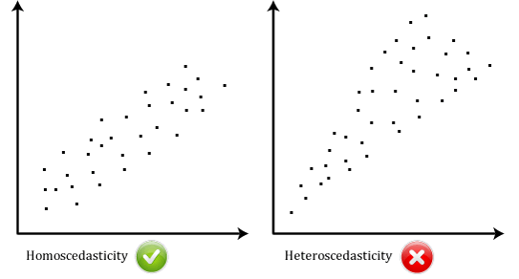
Regression Assumptions - Errors -
Heteroskedasticity
The error distribution at each X value has the same (but unknown) variance of σ²
Methods of detection: Plots of standardized residuals (y-axis) with Standardized predicted values (x-axis)
Different levels of variation for different x values
Same levels of variation for different x values

Slide 49
Regression Assumptions - Errors -
Heteroskedasticity
The error distribution at each X value has the same (but unknown) variance of σ²
Consequences, if violated
OLS will result in estimates of coefficients which are not precise. Also the standard error estimates of coefficients, are understated.
Remedial Actions
Transformations of data to stabilize variance
Weighted Least squares

Slide 50
Regression Assumptions - Predictor
Assumptions about the predictor (or independent) variables
The predictor variables (X₁ , X₂, X₃,…., X_{p} ) are uncorrelated to each other
To understand the consequences of violation of this rule let’s take a model.

Slide 51
Regression Assumptions - Predictor
Suppose we have a model that tries to predict a cricket player's batting average using the following equation:
Batting Average = b₀ + b₁* Training Intensity + b₂ * Age + b₃ *Year of Birth
Here, the predictor variables “Age" and “Year of Birth" are perfectly correlated, which violates the assumption that the predictor variables (X₁ , X₂, X₃,…., X_{p} ) should be uncorrelated to each other
.
Our Multiple Regression Data
 | y (Total Runs) | x1 (Dot Balls) | x2 (Boundaries) | x3 (Main Bowlers' strike rate) | x4 (Main Batsmens' strike rate)
y (Total Runs) | 1.00
x1 (Dot Balls) | -0.97 | 1.00
x2 (Boundaries) | 0.92 | -0.87 | 1.00
x3 (Main Bowlers' strike rate) | -0.90 | 0.85 | -0.97 | 1.00
x4 (Main Batsmens' strike rate) | 0.46 | -0.39 | 0.59 | -0.52 | 1

Slide 52
Regression Assumptions - Predictor
The predictor variables (X₁ , X₂, X₃,…., X_{p} ) are uncorrelated to each other
Methods of detection
Pairwise Correlation values
VIF (Variance Inflation Factor)
Large changes in estimated coefficients, when a variable is added or deleted
Algebraic signs of estimated coefficients do not conform to expectations

Slide 53
Regression Assumptions - Predictor
Remedial actions
If the problem is restricted to distinct pairs of variables, choosing one variable only
Principal Components Regression
Ridge Regression

Slide 54
Regression Process (Iterative)
START
Choose a set of variables, form of model, method of fitting, Specific assumptions
Formulate the Problem
Fit the Model
Use method of fitting
Validate Assumptions
Residual plots, Outliers detection, Sensitivity analysis
No
ok?
Yes
Evaluate Fitted Model
Goodness of fit tests
No
ok?
Yes
STOP
Use the model for the intended purpose

Slide 55
Model Assessment
Model selection is important in multiple linear and nonlinear models
Data-rich situation: Randomly divide the data in three parts
Ideal Scenario: Data-rich situation
Train
Validation
Test
50%
25%
25%
Fit the models
Model selection
Model assessment
Best Model in Practice? Need a Criterion
Root Mean Square Error is a commonly used Criterion

Slide 56
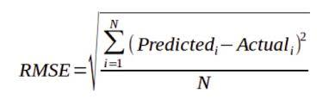
Illustration: Computing Root Mean Square
Error(RMSE)
Observation # | Actual Value | Predicted Value | Error = (Predicted - Actual) | Squared Error = (Predicted - Actual)²
1 | 100 | 110 | 10 | 100
2 | 90 | 80 | -10 | 100
3 | 55 | 62 | 7 | 49
4 | 104 | 112 | 8 | 64
5 | 68 | 74 | 6 | 36
N = 5 | Sum of Squared Error(SSE) |  |  | 349
 | Mean Squared Error (MSE) |  | (SSE) / N | 349/5 = 69.8
 | Root Mean Squared Error(RMSE) |  | Sqrt (MSE) | 8.35

Slide 57
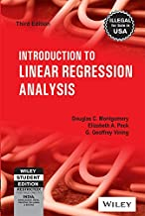
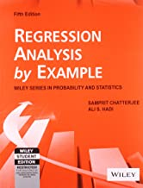
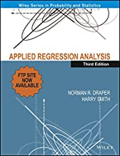
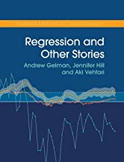
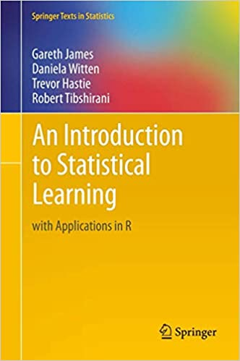
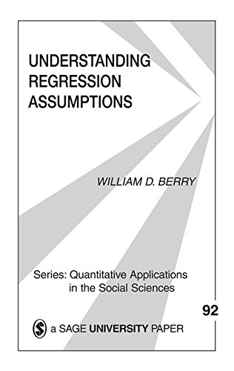
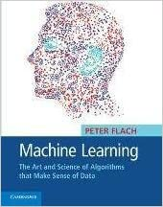
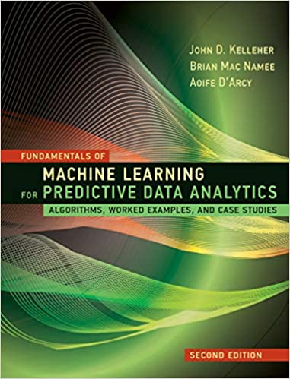
Suggestions on Books for Regression Analysis
Introductory, easy to follow, lots of examples, data sets available at publisher’s website
Very thorough coverage
Expensive, advanced treatment
Worth owning, not just for regression, but also for other learning topics
{Older edition is very affordable}

Slide 58

THANK YOU

